Slide 1
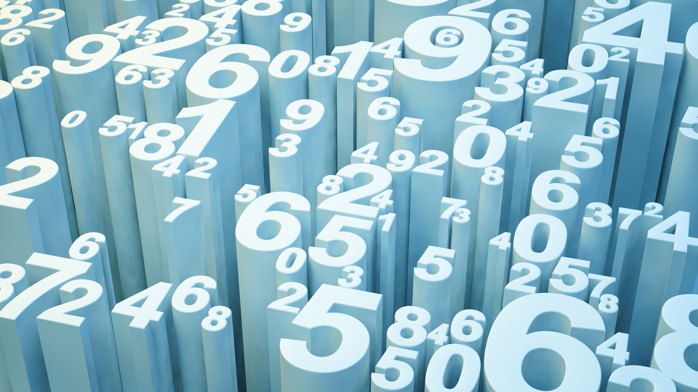
American Numerology
Or
“Culturally Significant Numbers”

Slide 2
Numbers
Individual Numbers
Cultural
Associations
with Numbers
Significant Dates
History
Other Expressions
Idioms
Fiction
Popular Culture
Sayings
Ideas

Slide 3
Individual Numbers
1 – The first, the best, the most important or powerful. Alternatively: alone, set apart, or unique.
2 – (a) The helper or replacement; (b) matching: twins, a pair, a couple, or a partnership; (c) opposites; (d) a liar (See Other Expressions – Two)
3 – A common quantity in examples; see the ancient Greek hendiatris, the Roman “rule of three,” or the Celtic “three things there be” poetry. According to old superstitions, both good and bad events allegedly happen in sets of three. Many religions have a trio of gods or three aspects of one God.
7 – Considered to be the “lucky number” in America.
9 – The number of lives that a cat (or a very lucky person) has.
12 – a dozen (common quantity of eggs, doughnuts, loaves of bread, etc.)
13 – Considered to be an unlucky number in America.

Slide 4
Individual Numbers
40 – A common quantity in classical literature, especially of Semitic origin (rain for 40 days and nights, lost in the desert for 40 years, Ali Baba and the 40 thieves)
42 – A literary reference from the book A Hitchhicker’s Guide to the Galaxy, the number 42 is supposed to be the answer to “the meaning of life, the universe, and everything” (but no one knows the question). In recent years, it has become a reference as a perfect number.
69 – An extremely common sexual reference. See Urban Dictionary for details.
72 – A common quantity in ancient faiths – 72 virgins for martyrs in Paradise, 72 names for God in the Kabbalah, 72 languages spoken at Babel, 72 disciples captured Osiris
420 – Used as a reference for cannabis possession or consumption, or the time at which it becomes “socially acceptable” to use cannabis (4:20 PM)
666 – A Christian Biblical reference to the Devil, the Antichrist, or the end of times (the Apocalypse). Strongly avoided by certain people.

Slide 5
Significant Times & Dates
Friday the 13th
A terrible, unlucky day; a reference to the horror movie with that name
11:11
Some people make a wish at this time.
12:00 AM
“The stroke of midnight” is the transition from one day to the next, so some people consider it a “magical” moment, when spells can break. (e.g., Cinderella)
12:00 PM
Often known as “high noon,” many punishments and fights used to happen at this time.

Slide 6
Significant Times & Dates
March 14th (3.14)
Pi Day; referring to the first 3 digits of $π$. Some Americans eat pie on this day.
March 15th (The Ides of March)
A day to “beware” or be cautious; a reference to the day that Julius Caesar was betrayed and stabbed by many Roman senators
April 1st (April Fool’s)
A day for pranks; a reference to the “32nd of March” pranks in Chaucer’s work
April 20th (4-20)
An unofficial holiday for cannabis; people who use cannabis often have a party together on this day.
May 4th ( “May the 4th”)
Star Wars Day; refers to the similar-sounding expression from the series, “May the force be with you.”

Slide 7
Other Expressions – “Zero”
zero in on something
If you zero in on something, you focus all your attention on that particular thing. "The detective immediately zeroed in on the missing book."
zero tolerance
If an activity or a certain type of behaviour is given zero tolerance, it will not be accepted, not even once. ”My mother has zero tolerance for violence in movies."
zero sum game
A situation in which one person's gain is the same as another's loss.

Slide 8
Other Expressions – “Half”
Half-assed*
Incomplete or poorly done due to low effort
half-baked
An incomplete plan
half the battle
A strong start to the initiative
half an eye
To watch something without giving it your full attention
half a mind
To think seriously about a plan but not yet reach a decision
* vulgar, impolite

Slide 9
Other Expressions – “One”
“numero uno” – the leader of the organization or person in command
“back to square one” – to start over (as in a game)
“have one too many” - to drink too much alcohol
“one for the road” – to have a drink right before leaving the bar
“cast the first stone” – to be the first person to criticize, the worthiest to judge
“in one fell swoop” – all at once, quickly and aggressively (like a hunting bird)
“one foot in the grave” – someone who is close to death
“have a one-track mind” – be focused on or obsessed with one topic
“look out for number one” – prioritize yourself, take care of your own interests
“sleep with one eye open” – be on guard for possible danger

Slide 10
Other Expressions – “Two/Second”
(a) Second place: “second-in-command,” “play second fiddle”
(b) Two of the same: “dynamic duo”, “two of a kind,” “two peas in a pod,”
(c) Opposites: “two sides to a coin,” “two sides to a story”
(d) Truth and falsehood: “two-faced”, “duplicitous,” “two-time”
Other:
“Put two and two together” – to realize something
“Kill two birds with one stone,” (to accomplish two tasks with one action, to be efficient)
“Put in your two cents,” (to give your opinion)
“Second a motion,” (to agree with or support another person’s suggestion)
“Second nature,” (very easy for someone, “comes naturally”)
“Second to none,” (the best)
“On second thought” (”I am changing my mind,” “I have reconsidered my decision”)
“In two minds” (undecided)
“Two can play at that game” (”I am willing to copy the other person’s manipulative behavior”)
“Have two left feet” (to be uncoordinated, a bad dancer)
“It takes two to tango” (the blame belongs to both participants)
“Two’s company, three’s a crowd” (see third wheel)
“The lesser of two evils” (the best choice when both options are unpleasant)
“No two ways about it” (only one option)
“That makes two of us” (I agree with you)

Slide 11
Other Expressions - Three
3
Religious triads: The Father, the Son, and the Holy Ghost (The Christian Holy Trinity); Brahma, Vishnu, Shiva (Hinduism); The Maiden, the Mother, and the Crone (Celtic); The Three Fates, The Three Graces, and The Three Furies (Greek); Jupiter, Neptune, and Pluto (Roman)
Mottos: Life, Liberty, and the Pursuit of Happiness (U.S. Declaration of Independence); Wisdom, Justice, Moderation (Georgia state motto), Union, Justice, Confidence (Louisiana state motto), Virtue, Liberty, and Independence (Pennsylvania state motto)
Romantic relationships: love triangle, ménage à trois
Language and Philosophy: Celtic “Three things there be” poetry, trichotomies
Idioms and sayings: “Three’s company,” “Three strikes, you’re out,” “Third time’s the charm,” “Good (or bad) things come in threes,” “three of a kind,” “third degree” = most severe, “phony as a three-dollar bill” = fake

Slide 12
Other Expressions – 4-10
4 – “on all fours” (to be on hands and knees), “four-letter word” (swear word)
5 – “fifth wheel” (to be the spare or extra person in the situation; sometimes “third wheel”), “five o’clock shadow” (the tiny hairs on a man’s face after a long day at work), “plead the fifth” (refuse to answer questions), “take five” (to take a short break), “five-finger discount” (stealing), “give me five” (ask for a high five)
6 – “six feet under” (dead and buried, hidden), “six of one, half a dozen of the other” (two choices are equal), “deep-six” (to throw away)
7 – “seventh heaven” (considered the ultimate form of heaven)
9 – “on cloud nine” (very, very happy), “dressed to the nines” (dressed elegantly), “nine times out of ten” (usually)
10 – “ten to one” (high odds, very likely)

Slide 13
Other Expressions – 11-100
11 – “at the eleventh hour” (at the last minute, shortly before the deadline)
12 – “a dime a dozen” (very cheap)
13 – “baker’s dozen” (12 plus a spare)
19 – “talk nineteen to the dozen” (talk very fast)
22 – “Catch-22” – a frustrating situation in which you cannot do one thing before doing a second, and you cannot do the second before doing the first
24-7 – Open 24 hours a day, seven days a week
40 – “have forty winks” (take a short nap)
86 – “to eighty-six” something is to get rid of it

Slide 14
Other Expressions – 101+
101 – a basic survey of the topic: “Using a turn signal is just Driving 101.”
1,000 – “Batting a thousand” (performing very well), “I’ve told you a thousand times” (repeating an instruction, with frustration)
9,000 – “over 9,000” is a recent expression. It is used by younger Americans to describe something extreme or impressive. It originally came from a mistranslation in Dragon Ball Z.
1,000,000 – “a million and one” (a lot), “never in a million years,” “look/feel like a million dollars” (look/feel great), “the million-dollar question” (the most important question)

Slide 15
Sources
https://www.learn-english-today.com/idioms/idiom-categories/numbers/numbers1.html
https://www.usingenglish.com/reference/idioms/cat/34.html
https://www.dailywritingtips.com/100-idioms-about-numbers/
https://www.eslbuzz.com/25-common-english-idioms-with-numbers/

